Slide 1
CGB1201 – JAVA PROGRAMMING
Department of Artificial Intelligence and Data Science
Academic Year: 2024 – 2025 (Odd Semester)
Register Number : 2303811724321101
Name : SHAHUL HAMEED M
Year : II
Semester : III
Section : B
Date : 3/12/2024

Slide 2
Title of the Project
EXPENSE TRACKER APPLICATION

Slide 3
Problem Identification
Expense records are often unorganized, making it difficult to track them effectively.
There is a lack of categorization for expenses, such as food, rent, or travel, which complicates analysis.
Users may overspend due to inadequate tracking of their budgets.
Manual calculations of totals or filtered expenses can be tedious and error-prone.
Without proper storage, there is a risk of data loss for expense records.
Users face challenges in analyzing spending trends to identify areas of high expenditure.

Slide 4
Objective
The objective of an expense tracker is to provide a simple and efficient system for managing financial transactions.
It helps users organize expenses, categorize spending, and monitor budgets to prevent overspending.
By automating calculations and offering insights into spending patterns, it reduces errors and improves financial awareness.
The tracker ensures secure data storage, accessibility, and scalability, while alerts and reports aid in better financial control and decision-making.

Slide 5
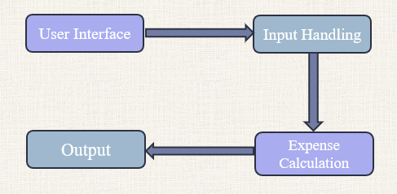
Proposed Architecture

Slide 6
Java Programming - Concepts Used
1.Object-Oriented Programming (OOP): The application uses classes to represent real-world entities, demonstrating encapsulation and abstraction.
2.Swing Framework: Java Swing is utilized for creating the graphical user interface, including components like `JFrame`, `JTextField`, and `JButton`.
3.Collections Framework: An `ArrayList` is used to store and manage expense data dynamically, enabling efficient data manipulation and retrieval.

Slide 7
List of Modules
User Input Module
Expense Management Module
Budget Tracking Module
Expense Summary Module

Slide 8
Module Description
User Input :
Provides input fields for expenses and budget details.
Validates the inputs for correctness (e.g., non-empty, valid amount).
Expense Management :
Adds new expenses with category, amount, and date details to the system.
Stores the expenses dynamically in a structured format (ArrayList).
Maintains a categorized list of all expenses for further analysis.

Slide 9
Module Description (Cont..)
Budget Tracking :
Allows users to set and update their financial budget.
Calculates the total expenses and the remaining budget dynamically.
Alerts users if expenses exceed the set budget.
Expense Summary :
Displays expenses in a tabular format with columns like category, amount, and date.
Provides insights into total expenses and remaining budget in real-time.
Ensures clarity through an organized and user-friendly summary layout.

Slide 10
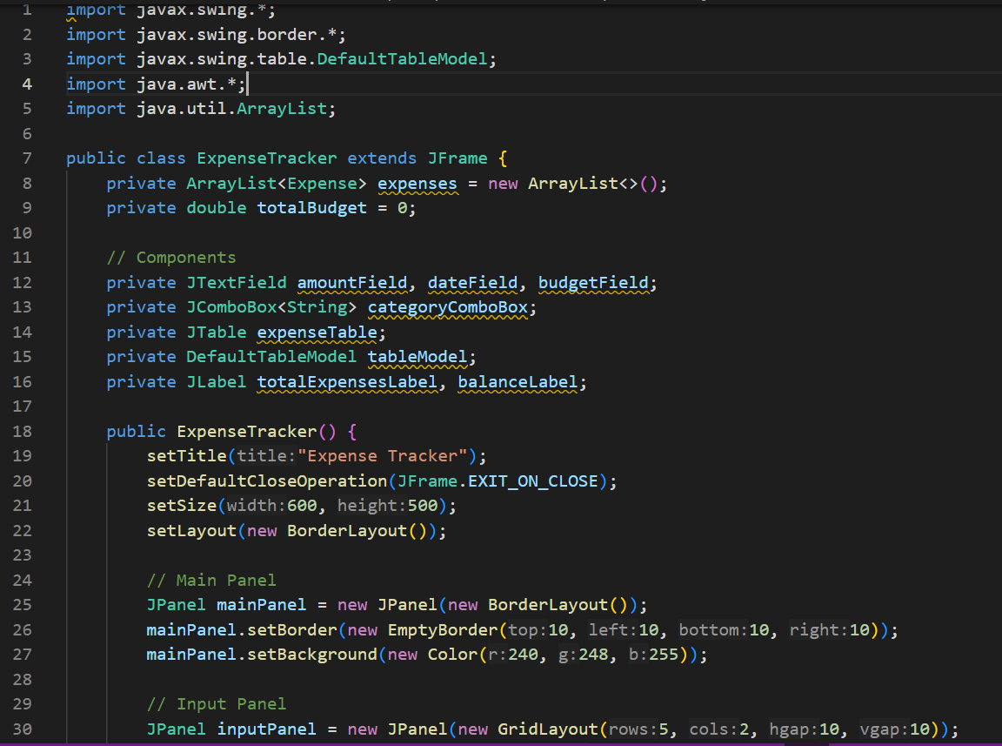
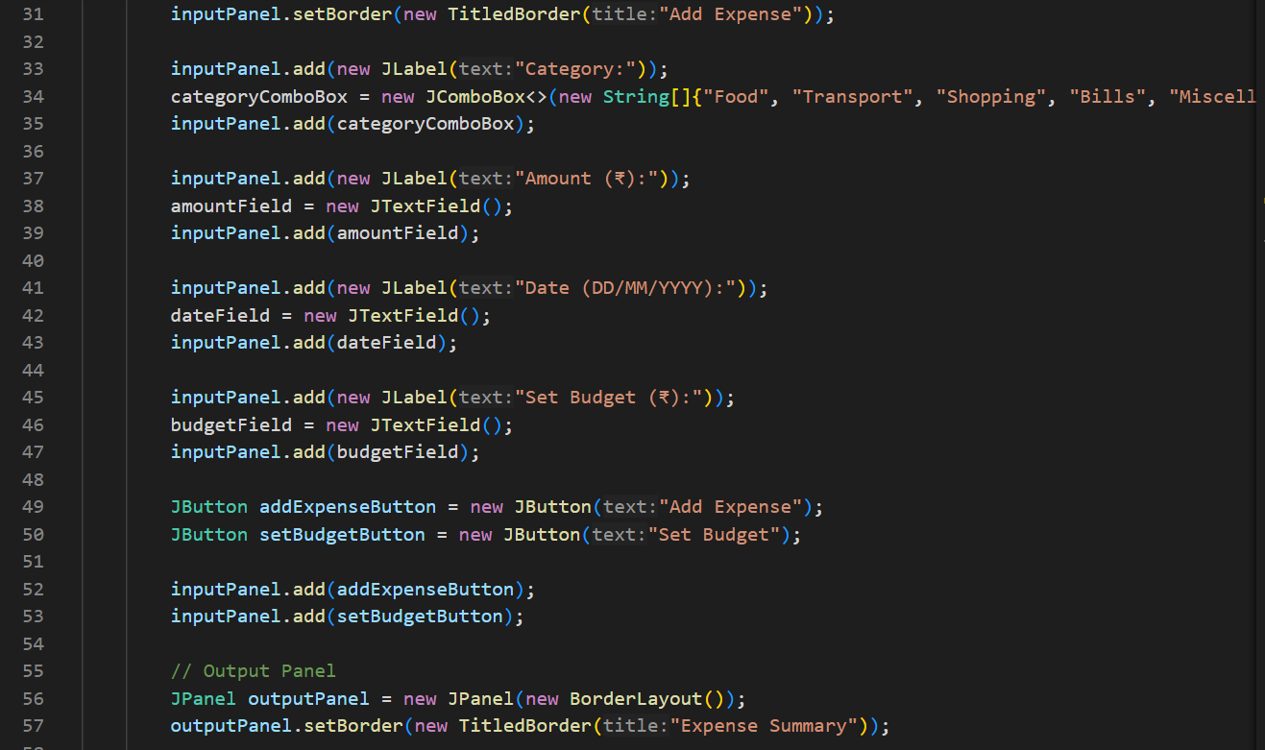
Source Code

Slide 11
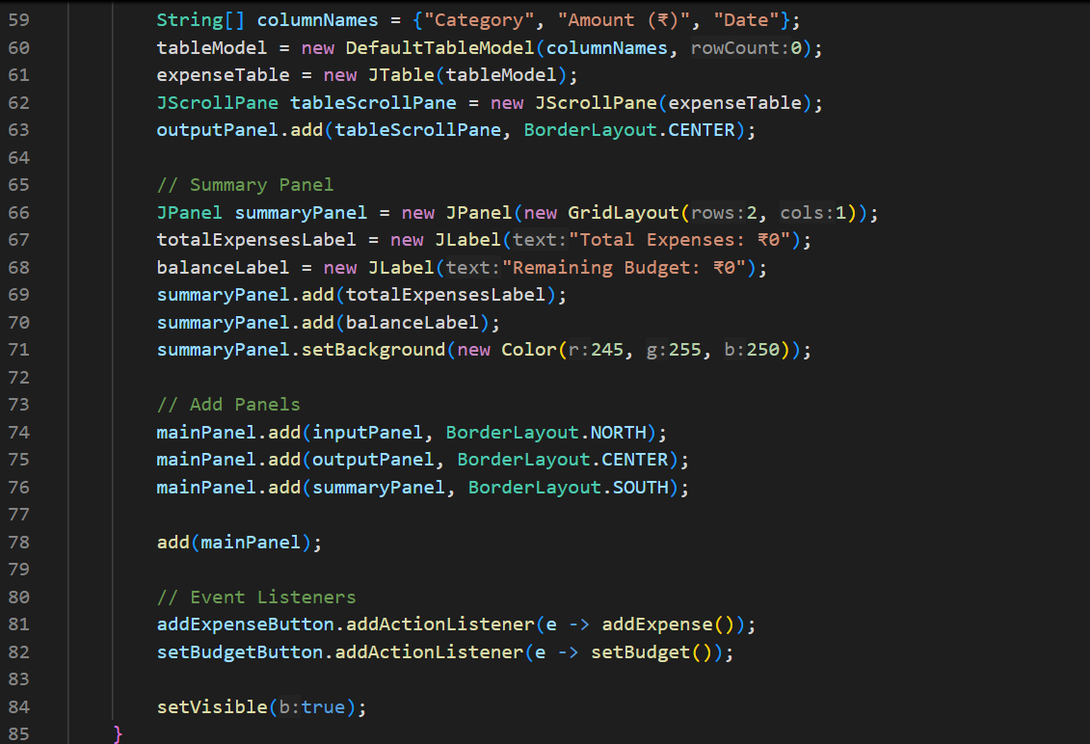
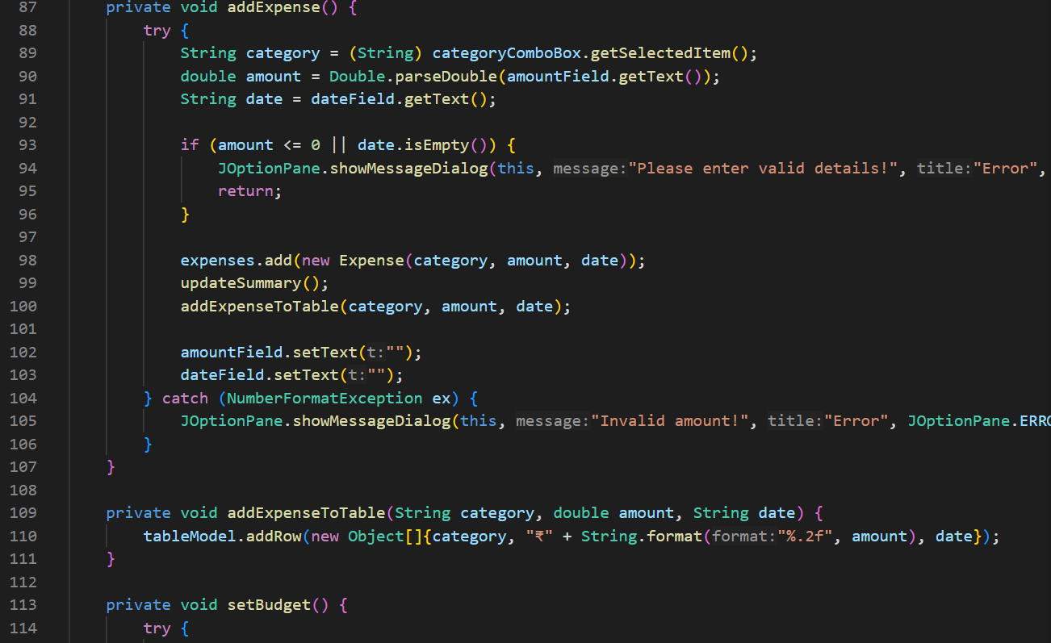
Source Code

Slide 12
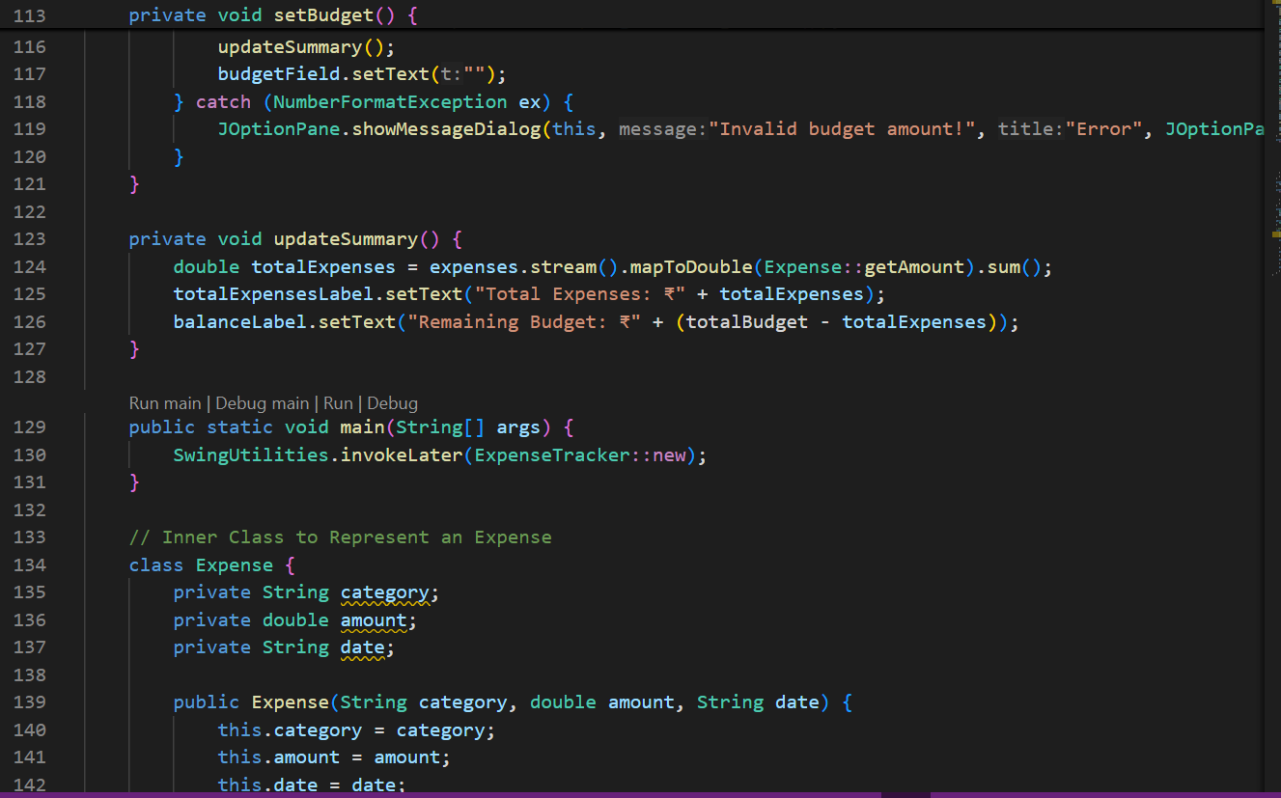
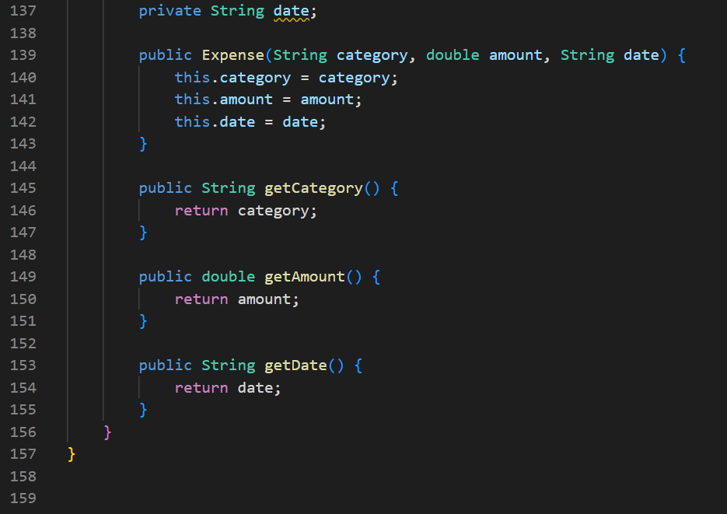
Source Code

Slide 13
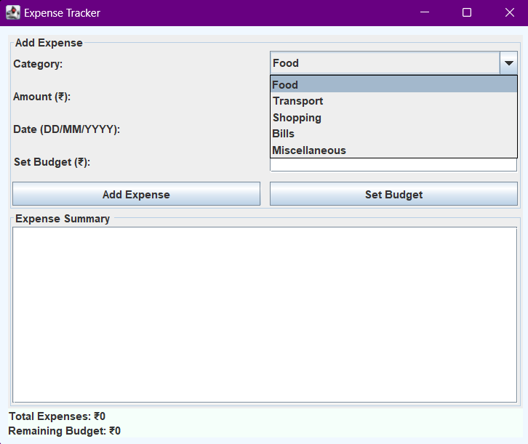
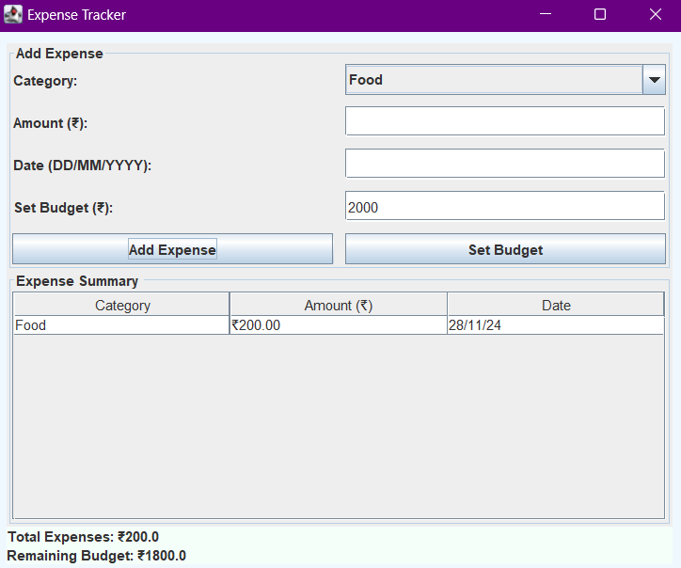
Results

Slide 14
Thank You
ANY QUERIES???

Slide 15
Conclusion
In conclusion, the Expense Tracker application provides an efficient solution for managing daily expenses by enabling users to record, categorize, and monitor their spending. With features like budget setting, real-time expense tracking, and clear summaries, the application promotes financial discipline and helps users avoid overspending.

